Slide 1


Uncovering the Electro-mechano-physiological Rules of Life​​
By Abygale Cochrane and Erica Hengartner
Advisor: Xin Tang, Ph.D. (xin.tang@ufl.edu)
Integrative Mechanobiology & Biophysics Laboratory (IMBL)
Department of Mechanical & Aerospace Engineering
J. Crayton Pruitt Family Department of Biomedical Engineering

Slide 2
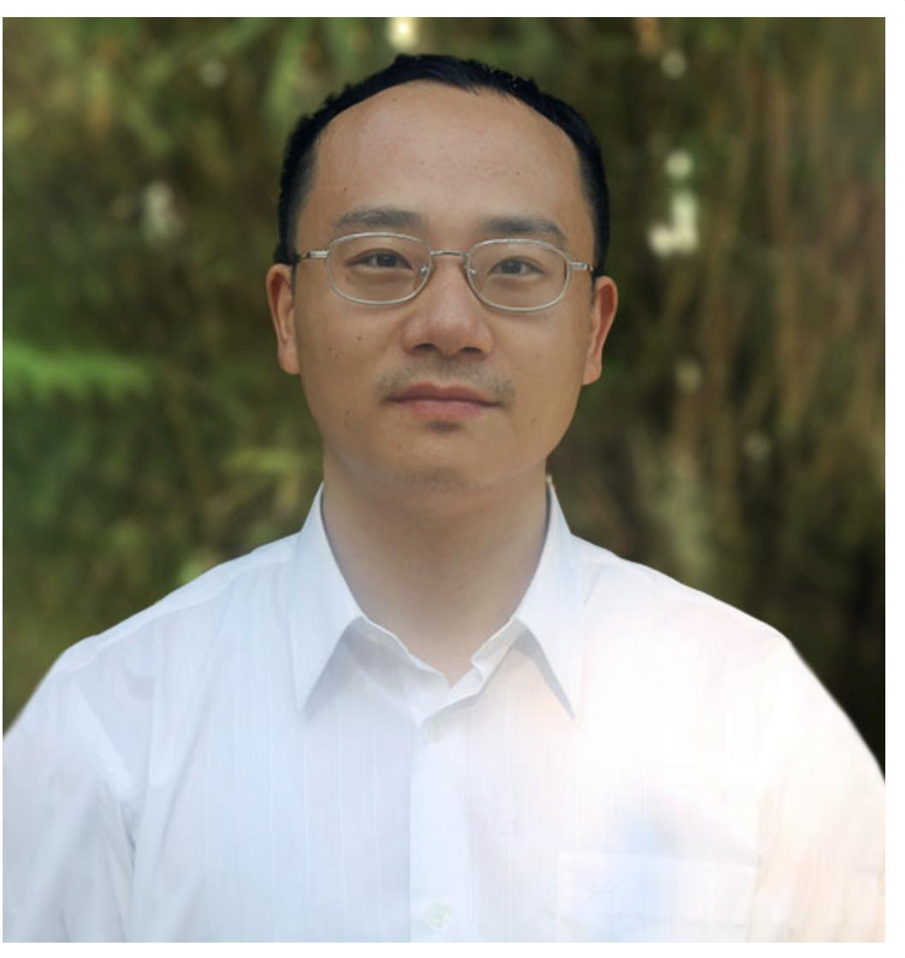

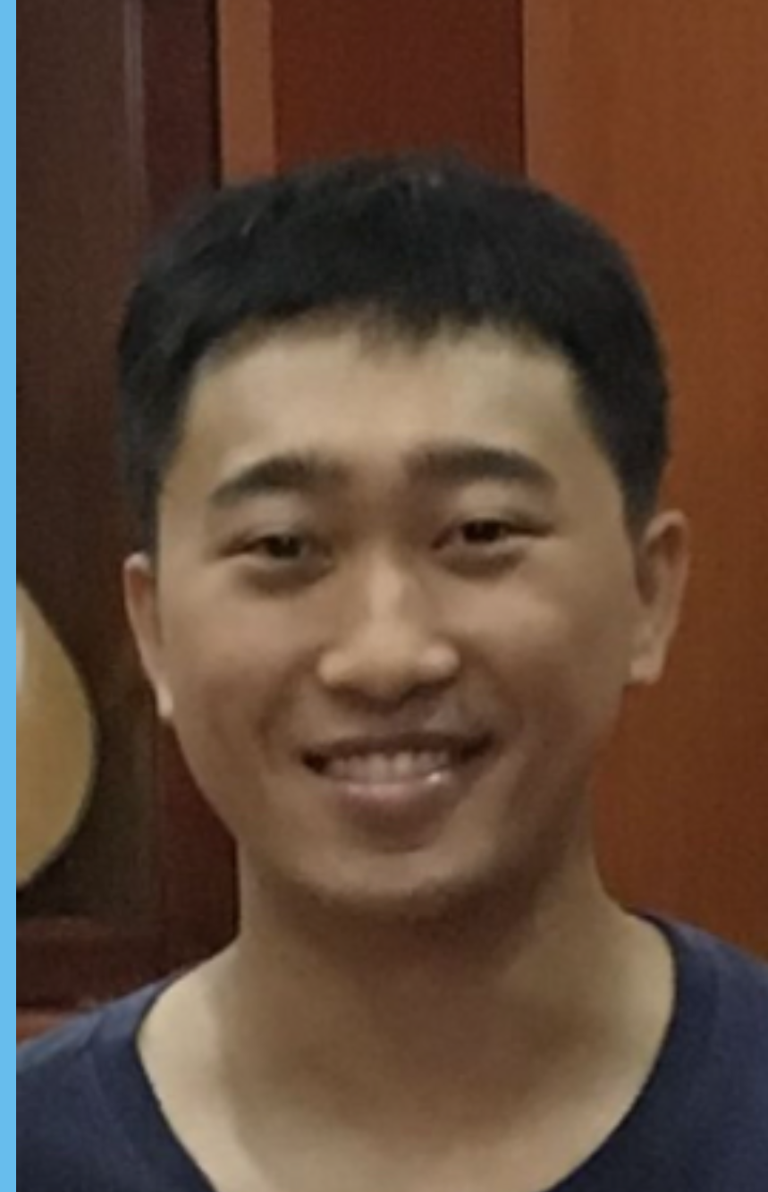


Our Team
Dr. Xin Tang
(xin.tang@ufl.edu)
Chenyu Liang
Miao Huang
Abygale Cochrane
Erica Hengartner

Slide 3








Acknowledgements
Dr. Warren Dixon
Dr. Jack Judy
Dr. Doug Spearot
Dr. Hitomi Greenslet
Dr. Robert Caudle
Dr. Mark Sheplak
Dr. Hugh
Fan
Dr. Habibeh
Khoshbouei
We sincerely appreciate the generous helps from and intellectual discussions with: Dr. Carlos Rinaldi-Ramos (ChE), Dr. John Wingard (UFHCC), Dr. Jonathan Licht (UFHCC), Dr. Rolf Renne (UFHCC), Dr. Thomas George (UFHCC), Dr. Paul Okunieff (UFHCC), Dr. Scott Banks (MAE), Dr. Ghatu Subhash (MAE), Dr. Malisa Sarntinoranont (MAE), Dr. Jing Pan (MAE), Dr. Yong Huang (MAE), Dr. Jacob N. Chung (MAE), Dr. Nam-Ho Kim (MAE), Dr. Ting Dong (MAE), Dr. Matthew Traum (MAE), Dr. David Hahn (Univ. of Arizona), Dr. Josephine Allen (MSE), Dr. Yenisel Cruz Almedida (Pain Science), Dr. Roger Fillingim (Clinical Pain), Dr. Yuqing Li (Neuroscience), Dr. Andrew Maurer (Neuroscience), Dr. Blanka Sharma (BME), Dr. John Neubert (Orthodontics), Dr. Ji-Hyun Lee (Biostatistics), Dr. Gila Brent (NIMET), and Dr. Jessie L-S Au (Optimum Therapeutics). ​

Slide 4

Outline
Objective: validate an integrative microscopy system to better interrogate coupled electrical and mechanical behaviors of neurons and cancer cells
Method: All-optical electro-mechano-physiological interrogation system
Experimental results: Neuron spikes and cancer cell calcium signaling
Applications: Direct link between behavior and functionality, treatment progression in neurodegenerative diseases and tumorigenesis
Previous methods: the patch-clamp
Experimental Design: GEPs, signal creation, selective illumination, optical paths
Future Direction: in vivo study of zebrafish neural activity
References
Questions

Slide 5
Outline
Objective: validate an integrative microscopy system to better interrogate coupled electrical and mechanical behaviors of neurons and cancer cells
Method: All-optical electro-mechano-physiological interrogation system
Experimental results: Neuron spikes and cancer cell calcium signaling
Applications: Direct link between behavior and functionality, treatment progression in neurodegenerative diseases and tumorigenesis
Previous methods: the patch-clamp
Experimental Design: GEPs, signal creation, selective illumination, optical paths
Future Direction: in vivo study of zebrafish neural activity
References
Questions

Slide 6
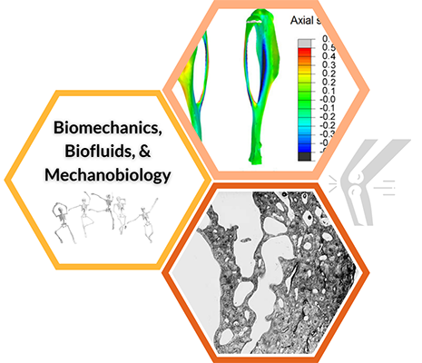
Objective
We are investigating the spatial-temporal dynamics of both electrical cell membrane potentials and mechanical forces within biological systems that modulate:
Proliferation
Communication
Computation
Migration
Notes:
Increasing evidence suggests that many biological systems, including but not limited to brain and heart, can modulate their electrical membrane potential and apply mechanical forces simultaneously to regulate key functions, such as proliferation, communication, computation, and migration.
Limited technology currently to better understand spatial-temporal dynamics of these signals

Slide 7
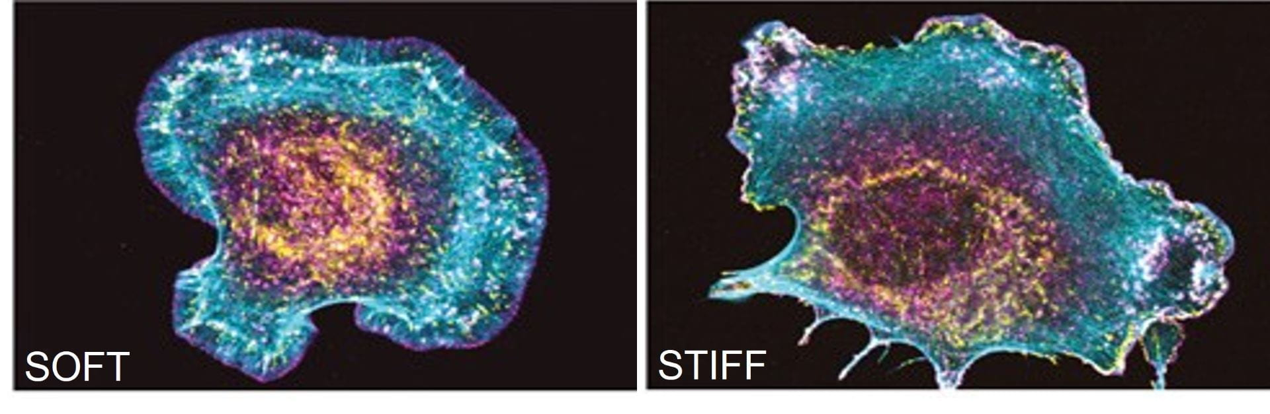
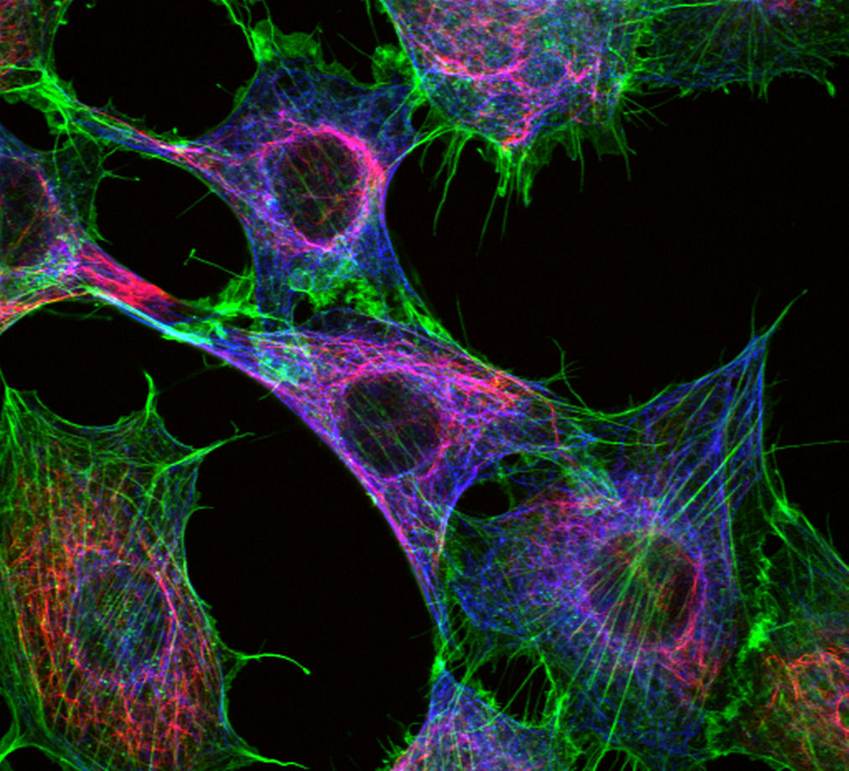

Electro-mechanical coupling
Mechanotransduction
Cytoskeletal Dynamics
Cardiac Muscle Contractions
(Oaks et. al. )
(https://biocytolab.com/research/)
(Image by Sergey Nivens)

Slide 8
Outline
Objective: validate an integrative microscopy system to better interrogate coupled electrical and mechanical behaviors of neurons and cancer cells
Method: All-optical electro-mechano-physiological interrogation system
Experimental results: Neuron spikes and cancer cell calcium signaling
Applications: Direct link between behavior and functionality, treatment progression in neurodegenerative diseases and tumorigenesis
Previous methods: the patch-clamp
Experimental Design: GEPs, signal creation, selective illumination, optical paths
Future Direction: in vivo study of zebrafish neural activity
References
Questions

Slide 9
Outline
Objective: validate an integrative microscopy system to better interrogate coupled electrical and mechanical behaviors of neurons and cancer cells
Method: All-optical electro-mechano-physiological interrogation system
Experimental results: Neuron spikes and cancer cell calcium signaling
Applications: Direct link between behavior and functionality, treatment progression in neurodegenerative diseases and tumorigenesis
Previous methods: the patch-clamp
Experimental Design: GEPs, signal creation, selective illumination, optical paths
Future Direction: in vivo study of zebrafish neural activity
References
Questions

Slide 10
Method: All-Optical Electro-Mechano-Physiological Interrogation System
A wide-area optical interrogation system that can both visualize and control electro-mechano-physiological signals.
All-optical: use of photon excitation and emission to collect visual data
Electro: in relation to action potentials and ion channels
Mechano: in relation to external environmental forces and mechanical cell processes
Physiological: better understanding the functioning of biological systems

Slide 11
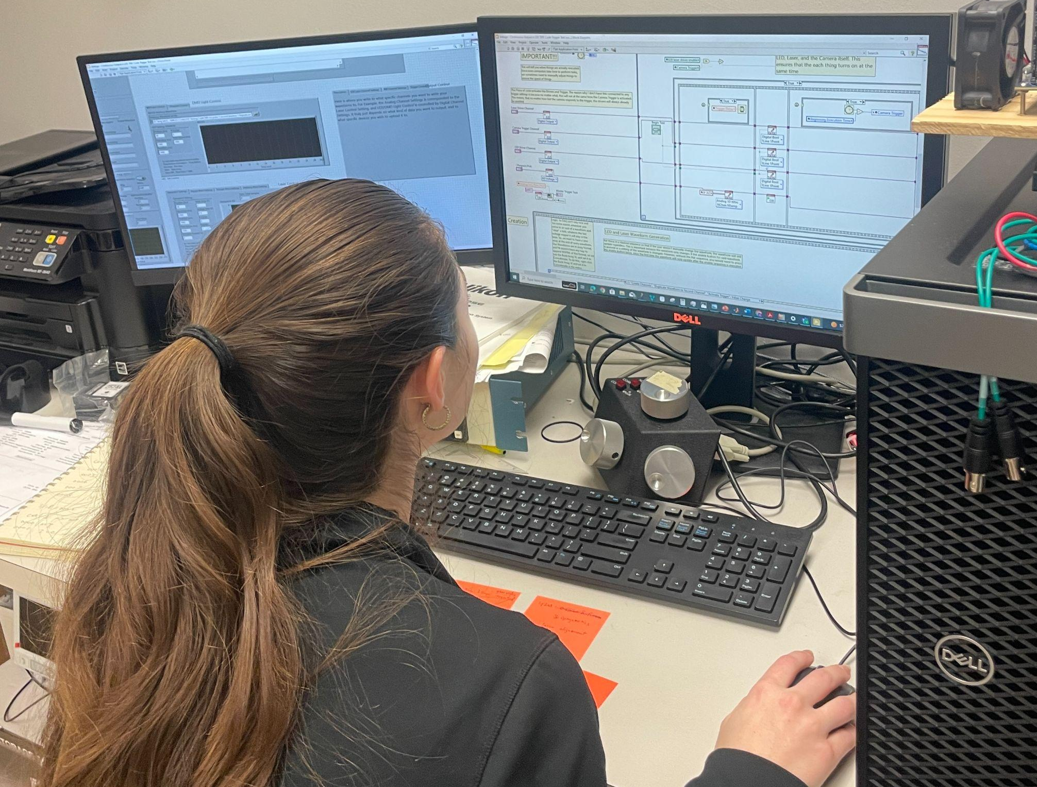
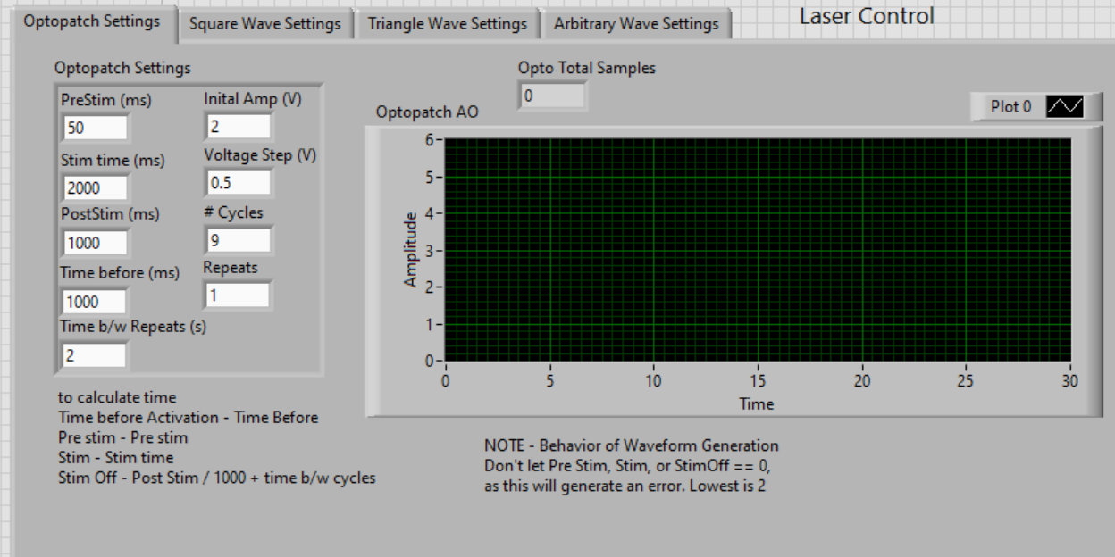
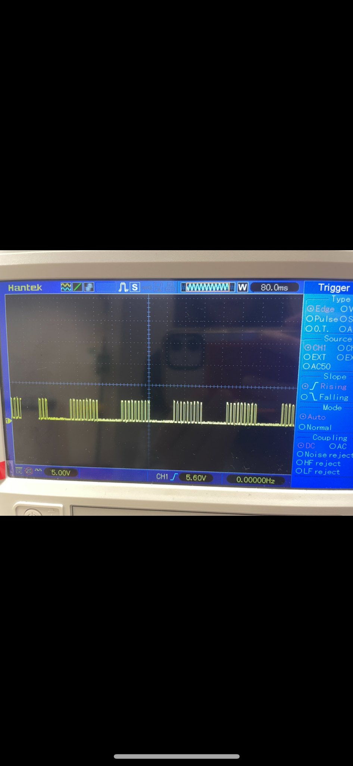
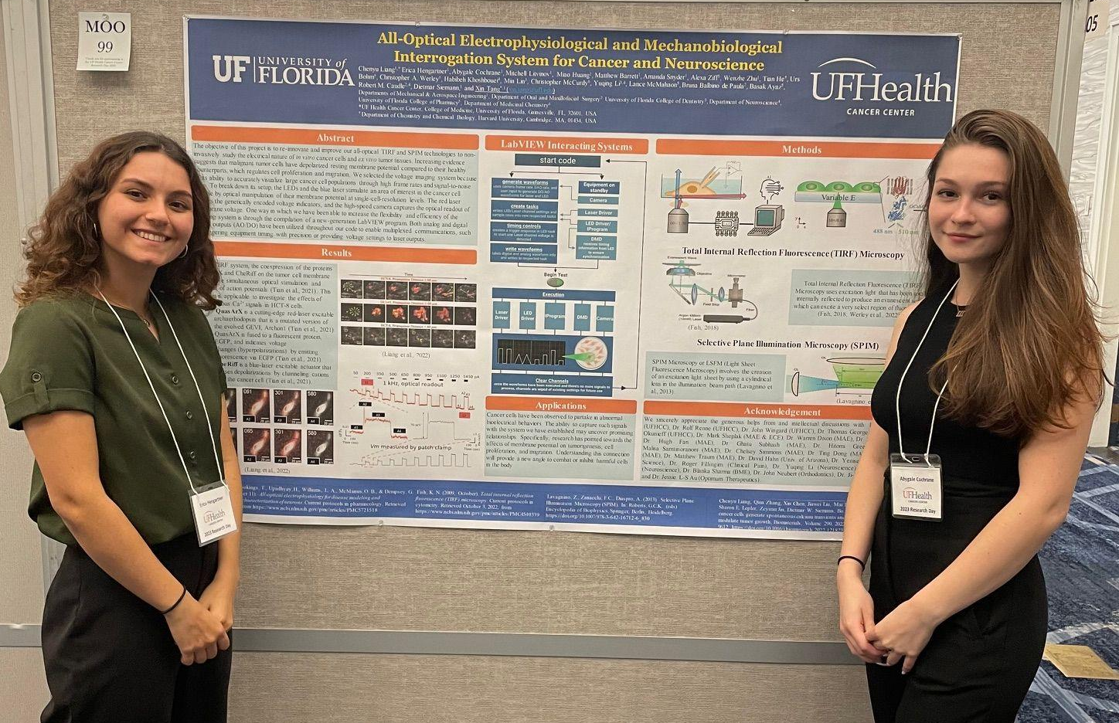
My research experience

Slide 12
Outline
Objective: validate an integrative microscopy system to better interrogate coupled electrical and mechanical behaviors of neurons and cancer cells
Method: All-optical electro-mechano-physiological interrogation system
Experimental results: Neuron spikes and cancer cell calcium signaling
Applications: Direct link between behavior and functionality, treatment progression in neurodegenerative diseases and tumorigenesis
Previous methods: the patch-clamp
Experimental Design: GEPs, signal creation, selective illumination, optical paths
Future Direction: in vivo study of zebrafish neural activity
References
Questions

Slide 13
Outline
Objective: validate an integrative microscopy system to better interrogate coupled electrical and mechanical behaviors of neurons and cancer cells
Method: All-optical electro-mechano-physiological interrogation system
Experimental results: Neuron spikes and cancer cell calcium signaling
Applications: Direct link between behavior and functionality, treatment progression in neurodegenerative diseases and tumorigenesis
Previous methods: the patch-clamp
Experimental Design: GEPs, signal creation, selective illumination, optical paths
Future Direction: in vivo study of zebrafish neural activity
References
Questions

Slide 14
Full length video of neuron firing
S2 AP.avi

Slide 15
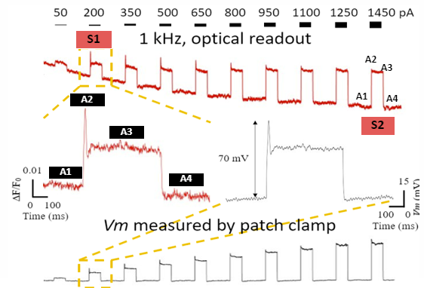
Neuronal Results (graphical analysis)
QuasAr readout proportionally responsive to voltage stimulus
Membrane potential measured by patch-clamp tool

Slide 16
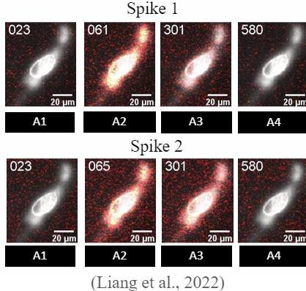
Neuronal Results (in vitro, ex vivo, and in vivo)

Slide 17
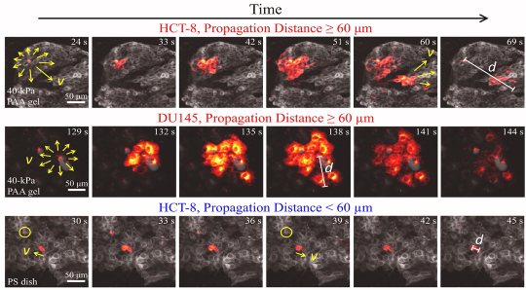
Cancer Cell Results
Readout of spontaneous Ca+ signals in HCT-8 Cells
Liang C, et al. Biomaterials, 2022
Xin Y, et al. Oncogene (Nature), 2023

Slide 18
Outline
Objective: validate an integrative microscopy system to better interrogate coupled electrical and mechanical behaviors of neurons and cancer cells
Method: All-optical electro-mechano-physiological interrogation system
Experimental results: Neuron spikes and cancer cell calcium signaling
Applications: Direct link between behavior and functionality, treatment progression in neurodegenerative diseases and tumorigenesis
Previous methods: the patch-clamp
Experimental Design: GEPs, signal creation, selective illumination, optical paths
Future Direction: in vivo study of zebrafish neural activity
References
Questions

Slide 19
Outline
Objective: validate an integrative microscopy system to better interrogate coupled electrical and mechanical behaviors of neurons and cancer cells
Method: All-optical electro-mechano-physiological interrogation system
Experimental results: Neuron spikes and cancer cell calcium signaling
Applications: Direct link between behavior and functionality, treatment progression in neurodegenerative diseases and tumorigenesis
Previous methods: the patch-clamp
Experimental Design: GEPs, signal creation, selective illumination, optical paths
Future Direction: in vivo study of zebrafish neural activity
References
Questions

Slide 20
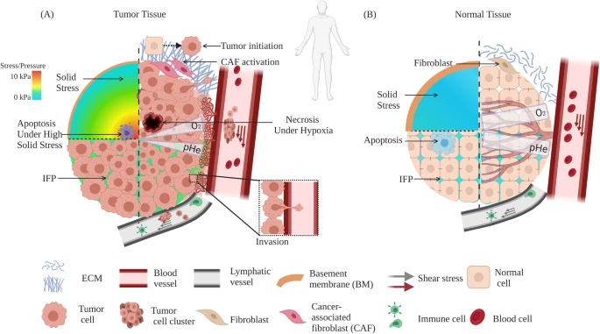
Applications (in vitro, ex vivo, and in vivo)
We can apply the system for a variety of cell types understand the relationship between bio-electric-mechano-physiological behaviors and functionality:
Cancer Cells:
Tumorigenesis
Self Integration
Migration
Tumor slice imaging

Slide 21
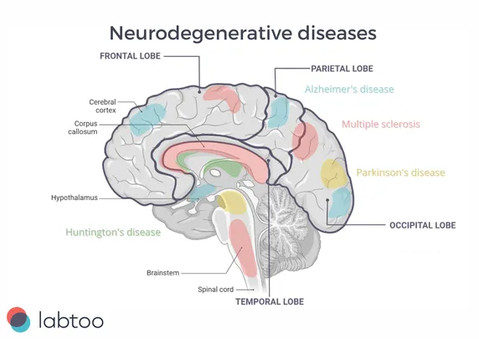
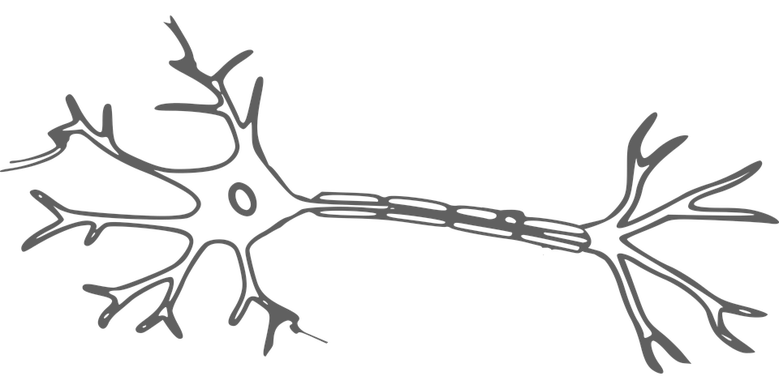
Applications (in vitro, ex vivo, and in vivo) cont.
Neurons:
Brain signal variations indications
Neural Networks
Treatment methods for neurological diseases

Slide 22
Outline
Objective: validate an integrative microscopy system to better interrogate coupled electrical and mechanical behaviors of neurons and cancer cells
Method: All-optical electro-mechano-physiological interrogation system
Experimental results: Neuron spikes and cancer cell calcium signaling
Applications: Direct link between behavior and functionality, treatment progression in neurodegenerative diseases and tumorigenesis
Previous methods: the patch-clamp
Experimental Design: GEPs, signal creation, selective illumination, optical paths
Future Direction: in vivo study of zebrafish neural activity
References
Questions

Slide 23
Outline
Objective: validate an integrative microscopy system to better interrogate coupled electrical and mechanical behaviors of neurons and cancer cells
Method: All-optical electro-mechano-physiological interrogation system
Experimental results: Neuron spikes and cancer cell calcium signaling
Applications: Direct link between behavior and functionality, treatment progression in neurodegenerative diseases and tumorigenesis
Previous methods: the patch-clamp
Experimental Design: GEPs, signal creation, selective illumination, optical paths
Future Direction: in vivo study of zebrafish neural activity
References
Questions

Slide 24
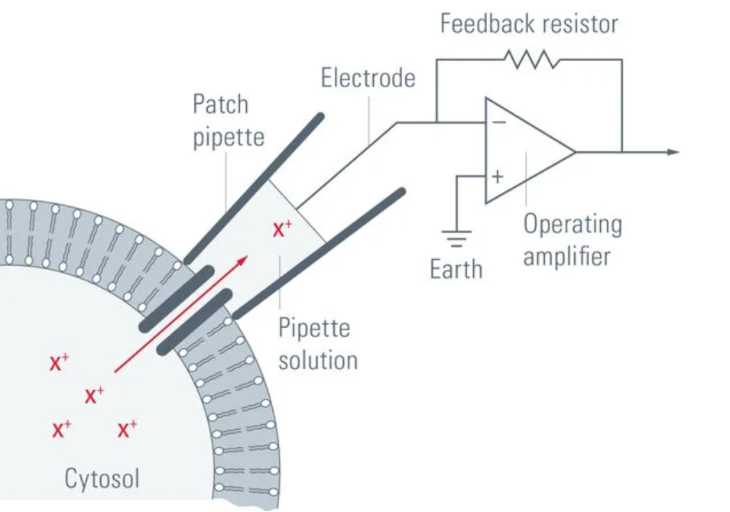
The Patch-Clamp Method
Previous method for observation of membrane potentials
Small piercing in membrane
Utilized electrical circuitry to measure amplified, readable voltage
Notes:
https://www.leica-microsystems.com/science-lab/life-science/the-patch-clamp-technique/

Slide 25
Outline
Objective: validate an integrative microscopy system to better interrogate coupled electrical and mechanical behaviors of neurons and cancer cells
Method: All-optical electro-mechano-physiological interrogation system
Experimental results: Neuron spikes and cancer cell calcium signaling
Applications: Direct link between behavior and functionality, treatment progression in neurodegenerative diseases and tumorigenesis
Previous methods: the patch-clamp
Experimental Design: GEPs, signal creation, selective illumination, optical paths
Future Direction: in vivo study of zebrafish neural activity
References
Questions

Slide 26
Outline
Objective: validate an integrative microscopy system to better interrogate coupled electrical and mechanical behaviors of neurons and cancer cells
Method: All-optical electro-mechano-physiological interrogation system
Experimental results: Neuron spikes and cancer cell calcium signaling
Applications: Direct link between behavior and functionality, treatment progression in neurodegenerative diseases and tumorigenesis
Previous methods: the patch-clamp
Experimental Design: GEPs, signal creation, selective illumination, optical paths
Future Direction: in vivo study of zebrafish neural activity
References
Questions

Slide 27
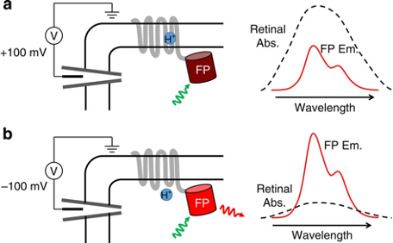
Genetically Engineered Proteins - QuasArX
QuasArX is a red-light excitable archaerhodopsin that monitors voltage activity through changes in fluorescence intensity.

Slide 28
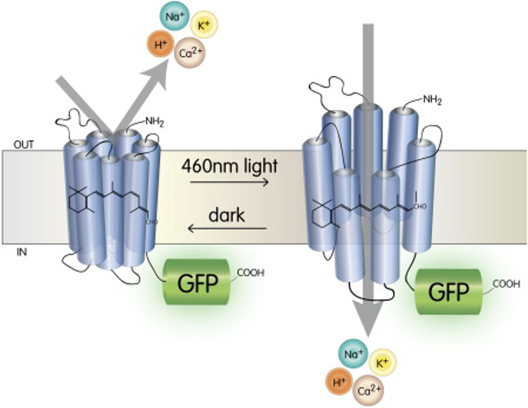
Genetically Engineered Proteins - CheRiff
CheRiff is an ion channel that is blue-light sensitive. It stimulates action potentials by causing depolarizations.

Slide 29
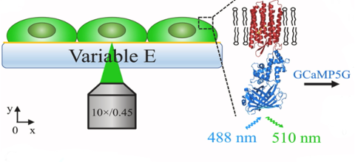
Genetically Engineered Proteins - GCaMP5G
GCaMP5G: genetically encoded calcium indicator with blue excitation and green emission
Can fluorescently visualize and collect data on calcium signaling in HCT-8 cells

Slide 30
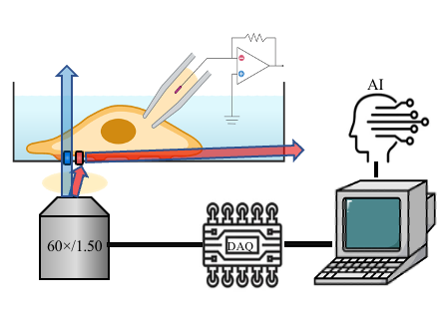
Hardware Controls
Signal information sent out from computer
Processed by DAQ Card
Execution of hardware for simultaneous excitation and emission of fluorescent proteins
Full FOV: 43.3 x 43.3 um

Slide 31
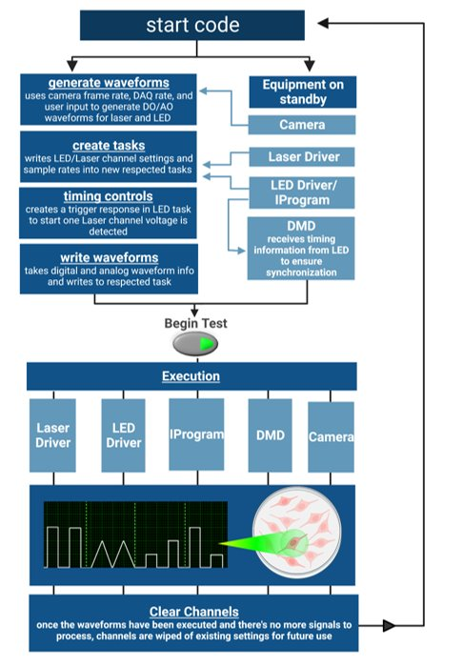
Labview Interactive System
Why is it important?
Customized automatic operation
Centralizes controls
Synchronization
Flexible signal creation/acquisition
Waveform types:
Square
Triangle
Arbitrary
Optopatch
Sinusoidal

Slide 32
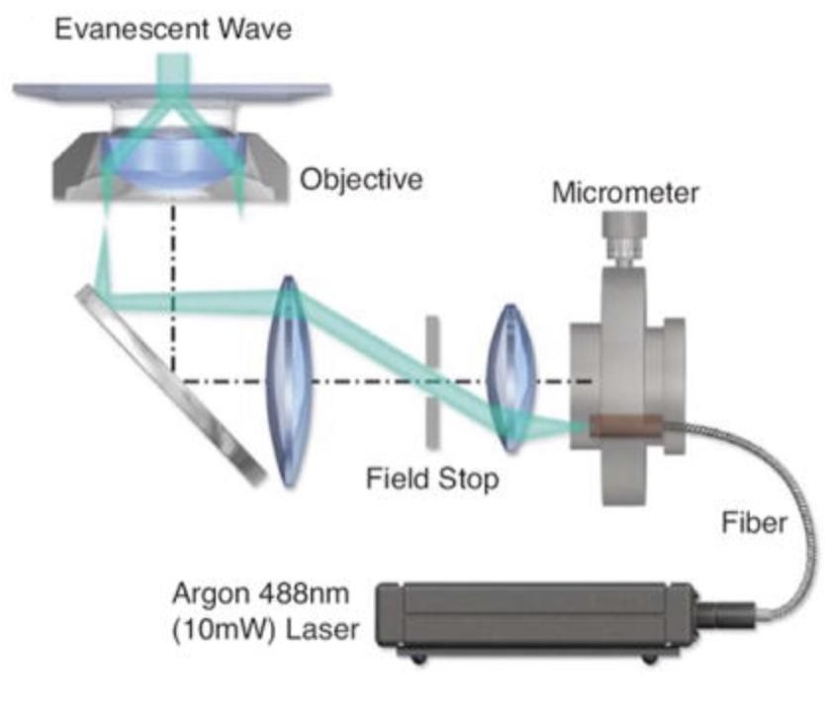
Microscopy Set-Ups: TIRF (in vitro and ex vivo)
Total
Internal
Reflection
Fluorescence
Creates rapidly decaying evanescent excitation wave to image fluorescent molecules within direct vicinity without interference
(Fish, 2018)​
Notes:
The total internal reflection of light at the glass-liquid boundary creates an evanescent wave. These waves have a notoriously rapid exponential decay, allowing us to accurately image fluorescent molecules within direct vicinity without interference

Slide 33
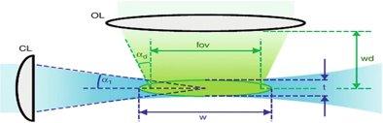
Microscopy Set-Ups: SPIM (in vivo and ex vivo)
Selective
Plane
Illumination
Microscopy
Able to acquire 3D fluorescence images by focusing laser light into a thin sheet and collecting a stack of 2 D images
(Lavagnino et al., 2013)

Slide 34
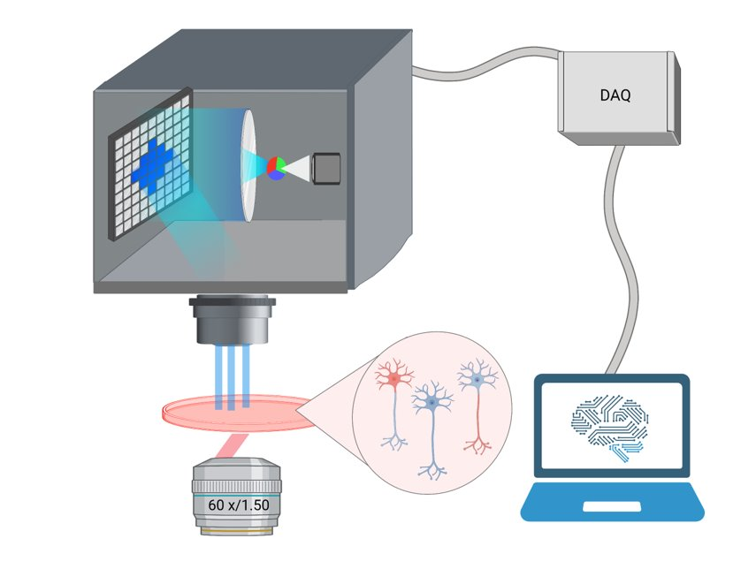
Selective Illumination
Digital Micromirror Device (DMD)
Illuminates ONLY regions of interest within cell
Improves signal-to-noise ratio for high resolution imaging

Slide 35
Outline
Objective: validate an integrative microscopy system to better interrogate coupled electrical and mechanical behaviors of neurons and cancer cells
Method: All-optical electro-mechano-physiological interrogation system
Experimental results: Neuron spikes and cancer cell calcium signaling
Applications: Direct link between behavior and functionality, treatment progression in neurodegenerative diseases and tumorigenesis
Previous methods: the patch-clamp
Experimental Design: GEPs, signal creation, selective illumination, optical paths
Future Direction: in vivo study of zebrafish neural activity
References
Questions

Slide 36
Outline
Objective: validate an integrative microscopy system to better interrogate coupled electrical and mechanical behaviors of neurons and cancer cells
Method: All-optical electro-mechano-physiological interrogation system
Experimental results: Neuron spikes and cancer cell calcium signaling
Applications: Direct link between behavior and functionality, treatment progression in neurodegenerative diseases and tumorigenesis
Previous methods: the patch-clamp
Experimental Design: GEPs, signal creation, selective illumination, optical paths
Future Direction: in vivo study of zebrafish neural activity
References
Questions

Slide 37
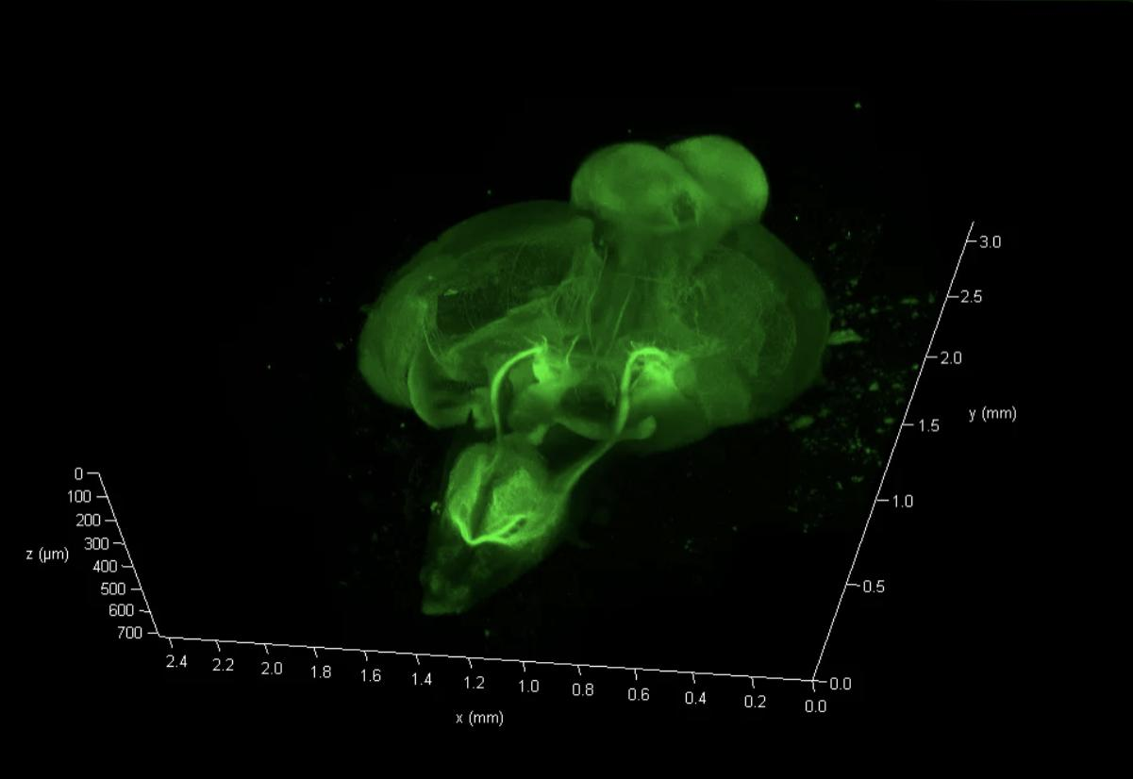
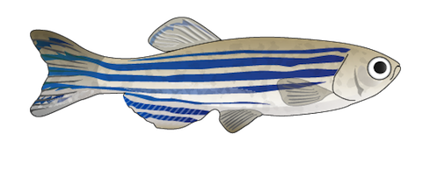
On-going Work
By expanding the system to 3D we will be able to study in the vault zebrafish brain to determine brain signal variations in response to visual stimuli.

Slide 38
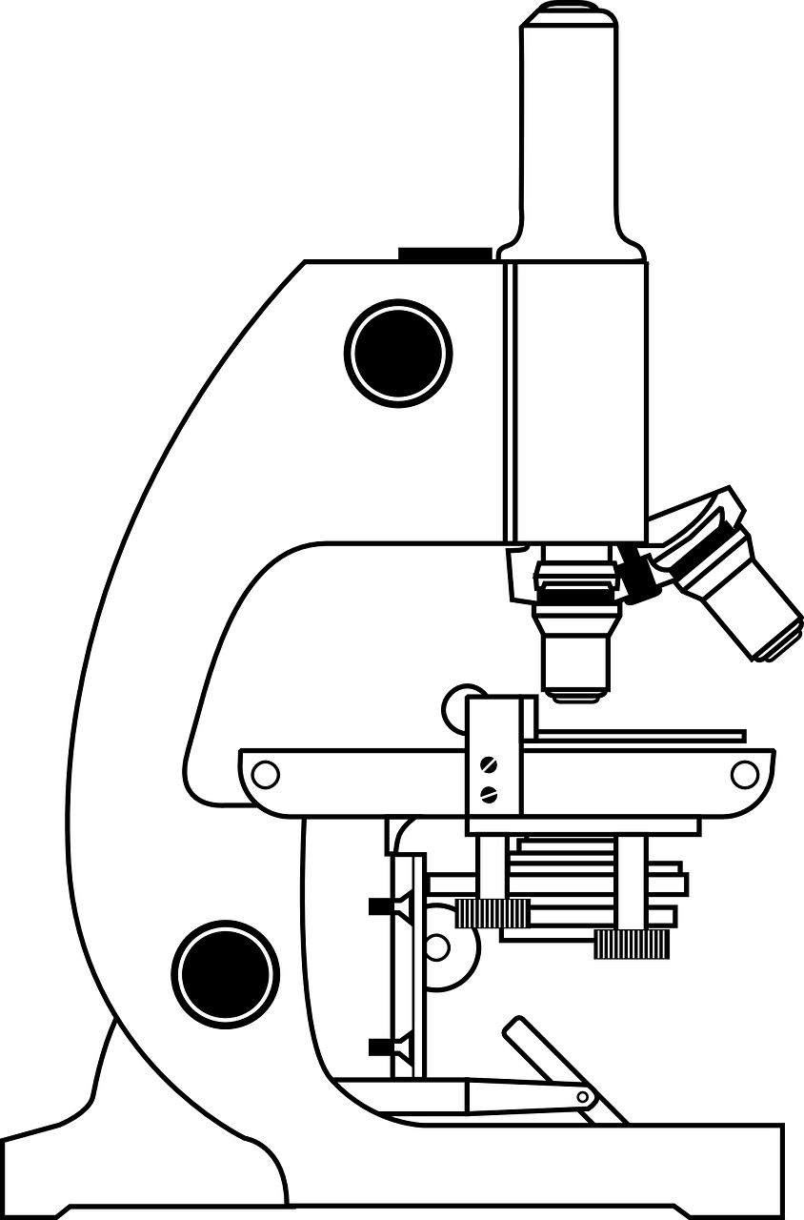
The Ideal System
High-speed (1KHz)
Synchronized
Spatial precision/ resolution
High signal-to-noise ratio
Throughput
Low phototoxicity
Long-term and non-invasive study
In vivo applications
Through integrative biological engineering, we are able to non-invasively study neuron firing patterns and calcium signaling to better understand electro-mechanical processes that promote communication, migration, and proliferation.

Slide 39
Outline
Objective: validate an integrative microscopy system to better interrogate coupled electrical and mechanical behaviors of neurons and cancer cells
Method: All-optical electro-mechano-physiological interrogation system
Experimental results: Neuron spikes and cancer cell calcium signaling
Applications: Direct link between behavior and functionality, treatment progression in neurodegenerative diseases and tumorigenesis
Previous methods: the patch-clamp
Experimental Design: GEPs, signal creation, selective illumination, optical paths
Future Direction: in vivo study of zebrafish neural activity
References
Questions

Slide 40
Outline
Objective: validate an integrative microscopy system to better interrogate coupled electrical and mechanical behaviors of neurons and cancer cells
Method: All-optical electro-mechano-physiological interrogation system
Experimental results: Neuron spikes and cancer cell calcium signaling
Applications: Direct link between behavior and functionality, treatment progression in neurodegenerative diseases and tumorigenesis
Previous methods: the patch-clamp
Experimental Design: GEPs, signal creation, selective illumination, optical paths
Future Direction: in vivo study of zebrafish neural activity
References
Questions

Slide 41
References
Chenyu Liang, Qian Zhang, Xin Chen, Jiawei Liu, Mai Tanaka, Shu Wang, Sharon E. Lepler, Zeyuan Jin, Dietmar W. Siemann, Bo Zeng, Xin Tang, Human cancer cells generate spontaneous calcium transients and intercellular waves that modulate tumor growth, Biomaterials, Volume 290, 2022, 121823, ISSN 0142-9612, https://doi.org/10.1016/j.biomaterials.2022.121823.
Werley, C. A., Brookings, T., Upadhyay, H., Williams, L. A., McManus, O. B., & Dempsey, G. T. (2017, September 11). All-optical electrophysiology for disease modeling and pharmacologicalf characterization of neurons. Current protocols in pharmacology. Retrieved October 3, 2022, from https://www.ncbi.nlm.nih.gov/pmc/articles/PMC5721518
Fish, K. N. (2009, October). Total internal reflection fluorescence (TIRF) microscopy. Current protocols in cytometry. Retrieved October 3, 2022, from https://www.ncbi.nlm.nih.gov/pmc/articles/PMC4540339
Lavagnino, Z., Zanacchi, F.C., Diaspro, A. (2013). Selective Plane Illumination Microscopy (SPIM). In: Roberts, G.C.K. (eds) Encyclopedia of Biophysics. Springer, Berlin, Heidelberg. https://doi.org/10.1007/978-3-642-16712-6_830
Lamellipodium is a Myosin-Independent Mechanosensor. Oakes PW, Bidone TC, Beckham Y, Skeeters AV, Ramirez-San Juan GR, Winter SP, Voth GA, Gardel ML. Proc Natl Acad Sci USA. 2019; 115(11):2646-2651

Slide 42
Thank You!

Slide 43
Our Team
Dr. Xin Tang
(xin.tang@ufl.edu)
Chenyu Liang
Miao Huang
Abygale Cochrane
Erica Hengartner

Slide 44
Questions
Please email Dr. Xin Tang (xin.tang@ufl.edu) for additional inquiries

